Slide 1
AUTOMATION OF MINUTES OF MEETING USING NLP
SUPERVISOR:
Mrs. M.ANUSHIYA, M.B.A, M.TECH,
ASSISTANT PROFESSOR,
DEPARTMENT OF AI&DS.
PRESENTED BY:
NARESHKUMAR A (E22ASR036)
RAJEEV R (E22ASR045)

Slide 2
Motivation/Introduction
Why was this project chosen
Manual meeting documentation is time-consuming, error-prone, and inconsistent.
How did you manage to identify the need of the project
. We observed inefficiencies in current documentation practices and identified the need through research on existing tools, which lacked accuracy and integration with common communication platforms

Slide 3
Problem Identified
What is the process adopted to identify the problem
The problem was identified by analyzing the difficulties in manual meeting documentation, such as time consumption, errors, and inconsistencies. Research on existing methods highlighted the need for an automated solution to improve accuracy and efficiency.
What is the need to solve it
Manual meeting documentation is leading to miscommunication. An automated solution ensures accurate, efficient, and easily accessible meeting summaries.
How do you manage to solve it
The solution uses speech-to-text conversion and NLP-based summarization to automate the process. This reduces manual effort, minimizes errors, and provides structured meeting summaries for better productivity.

Slide 4
Proposed Solution
Objective of the proposed system
The objective of the proposed system is to automate meeting documentation using AI-driven speech-to-text conversion and NLP-based summarization. It aims to improve accuracy, reduce manual effort, enhance accessibility, and provide structured meeting summaries for better decision-making and productivity.
Unique findings
Automation – The system efficiently transcribes and summarizes meetings, reducing human effort.
High Accuracy – Uses advanced NLP and speech recognition models to improve transcription precision.
Time Efficiency – Reduces the time needed for manual note-taking and summarization.

Slide 5
Key Business Objectives
Clear & Measurable Goals
Achieve 90%+ accuracy in speech-to-text conversion for precise meeting transcripts.
Reduce summarization time by 70% compared to manual documentation.
Implement keyword-based search to enhance accessibility of meeting summaries.
Customer Satisfaction
Improve accuracy, speed, and usability of meeting summaries to enhance user experience. Provide a seamless interface for easy access to transcripts and summaries.

Slide 6
Key Business Objectives
Revenue Growth
Reduce costs by automating documentation, making it a cost-effective solution for businesses. Offer subscription-based or enterprise-level services to increase revenue.
Competitive Edge
Use advanced AI and NLP to provide a more accurate and efficient solution than existing tools. Ensure smooth integration with popular communication platforms to stay ahead in the market.

Slide 7
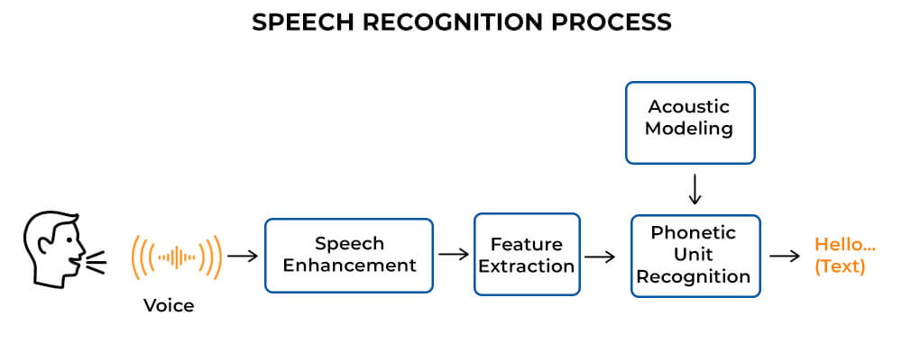
Architecture
Pre processing
Librosa,ASR
(lib function)
Database

Slide 8
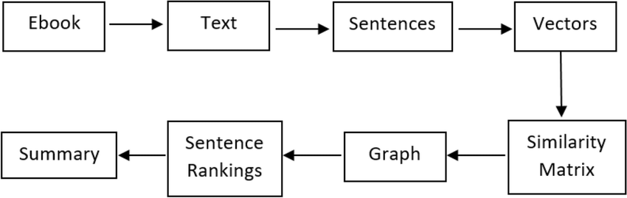
Architecture
Text summarize
Database
Output

Slide 9
Base paper Details
Title of the Paper: Joint Speech-Text Embeddings for Multitask Speech Processing
Journal Name: IEEE Xplore
Publication Date: 3 October, 2024
Authors: MICHAEL GIAN GONZALES , PETER CORCORAN ,NAOMI HARTE ,
MICHAEL SCHUKAT

Slide 10
Literature Review
S.NO : | TITTLE OF THE PAPER: | AUTHORS: | YEAR : | FINDING :
1 | Speech to text conversion and summarization for effective understanding and documentation | Vinnarasu A., Deepa V. Jose | 5, October 2019 | Google API, NLTK,
2 | Joint Speech-Text Embeddings for Multitask Speech Processing | Michael gian gonzales, Peter corcoran, Naomi harte | 15 October 2024. | Speech and text encoder, Specker recognition.
3 | Speech Recognition using Python | Velcia Mendonca, Sanjana M. Rao. AnjanaR, 1Teena S | 7 June 2023 | Google Cloud Speech-to-Text API, NLTK or spaCy
4 | Automatic text summarization techniques&methods | Adhika Pramita Widyassari, SupriadiRustad, GuruhFajarShidik | 2022 | Extractive and abstractive Summarize

Slide 11
Tools and technologies
S.NO | Category | Tools/Technologies
1 | Language | Python
2 | Speech Recognition | Whisper, Google Speech-to-Text API, DeepSpeech
3 | Audio Processing | pydub, wave, librosa
4 | NLP Libraries | spaCy, NLTK, Transformers

Slide 12
Design Process & Key Decisions
S.NO | Design Component | Decision/Reasoning
1 | Speech Recognition | Selected Whisper for its high accuracy in noisy environments
2 | Summarization Method | Choose extractive + abstractive NLP for richer summaries
3 | Multi-format Support | Enabled via audio preprocessing libraries like pydub
4 | User Interface | Simple GUI for uploading files and viewing summaries (future scope)
5 | Search Feature | Keyword-based lookup using frequency-based scoring and named entity recognition

Slide 13
Reference
Speech to text conversion and summarization for effective understanding and documentation - https://ijece.iaescore.com/index.php/IJECE/article/view/17795
Joint Speech-Text Embeddings for Multitask Speech Processing – https://ieeexplore.ieee.org/document/10704626
Speech Recognition using Python –
https://ijetms.in/Vol-7-issue-3/Vol-7-Issue-3-99.html
A Survey of Automatic Text Summarization Techniques for Indian and Foreign Languages- https://ieeexplore.ieee.org/document/7755587

Slide 14
THANK YOU!!

